Slide 1

Encrypting Data in SQL Server
Steve Jones
Editor in Chief
SQLServerCentral

Slide 2
Agenda
What is encryption?
Encryption in SQL Server
Communications
Transparent Data Encryption
Hashing
Keys
Symmetric Keys
Asymmetric Keys

Slide 3
Agenda
What is encryption?
Encryption in SQL Server
Communications
Transparent Data Encryption
Hashing
Keys
Symmetric Keys
Asymmetric Keys

Slide 4
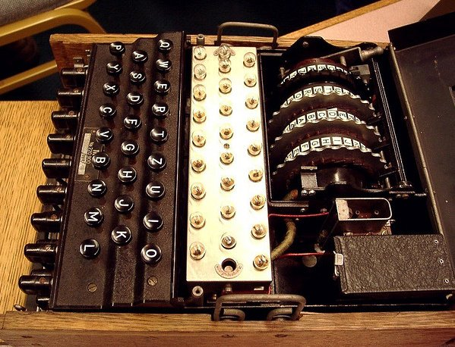
What is Encryption?
Notes:
What is encryption? The image is the Enigma Machine from WWII.

Slide 5
encryption is the process of transforming information (referred to as plaintext) using an algorithm (called a cipher) to make it unreadable to anyone except those possessing special knowledge, usually referred to as a key. The result of the process is encrypted information (in cryptography, referred to as ciphertext).
- Wikipedia
Notes:
From Wikipedia

Slide 6
Simple Ciphers
ABCDEFGHIJKLMNOPQRSTUVWXYZ
DEFGHIJKLMNOPQRSTUVWXYZABC
WKLV LV HQFUBSWHG
Notes:
A simple cipher, known as a substitution or rotation cipher. In this case, this is a ROT4. The bottom line is an encrypted string. The top line is the plain text line, and the second line is used to encrypt or decrypt the data.

Slide 7
Simple Ciphers
ABCDEFGHIJKLMNOPQRSTUVWXYZ
DEFGHIJKLMNOPQRSTUVWXYZABC
WKLV LV HQFUBSWHG
THIS IS ENCRYPTED
Notes:
And the decryption

Slide 8
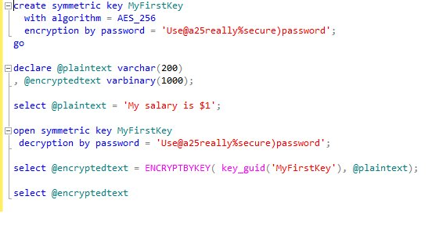
Complex Encryption
Results:
-------------------------------------------
0x00E2A26D824E22468392458DE6F450DA0100000025DE09EF3AD8D7C989E393BF9FE1368D04C1B9BEE086EFFDF6F77AF9E3A3B8142F23723D536C72C216D6F9B104A5E44A
Notes:
Here is a more complex encryption using a symmetric key in T-SQL.

Slide 9
Agenda
What is encryption?
Encryption in SQL Server
Communications
Transparent Data Encryption
Hashing
Keys
Symmetric Keys
Asymmetric Keys

Slide 10





Encryption in SQL Server
SQL Server Instance
Communication Link
(the wire)
Client
SQL Server memory
Client file system
Backup files
SQL Server data files
Notes:
Here is the essential link between a client and server. The client has a computer, with a file system and connect to the SQL Server instance across some communication link (the wire). The data in SQL Server is available in its memory (for querying, manipulating, etc.). The data gets stored on disk drives in the data files, and then is copied to backup files, either on disk or tape.

Slide 11
Encryption in SQL Server
SQL Server Instance
Communication Link
(the wire)
Client
SQL Server memory
Client file system
Backup files
SQL Server data files
Notes:
We can’t do much about the client file system. If clients copy/paste data into a text file, spreadsheet, etc., we lose control. Even if they take an image of the screen, they can store data unprotected on their local file system

Slide 12
Encryption in SQL Server
SQL Server Instance
Communication Link
(the wire)
Client
SQL Server memory
Client file system
Backup files
SQL Server data files
Notes:
We can’t do a lot to encrypt things on the client as that’s where we really need data decrypted so the client can read it.

Slide 13
Encryption in SQL Server
SQL Server Instance
Communication Link
(the wire)
Client
SQL Server memory
Client file system
Backup files
SQL Server data files
Notes:
We can encrypt the wire, using SSL communication in SQL Server, or some higher level tunneling like IPSec.

Slide 14
Encryption in SQL Server
SQL Server Instance
Communication Link
(the wire)
Client
SQL Server memory
Client file system
Backup files
SQL Server data files
Notes:
We can encrypt data in SQL Server’s memory. Not completely, but we can use one of our encryption methods to ensure that queries require keys to return the plaintext.

Slide 15
Encryption in SQL Server
SQL Server Instance
Communication Link
(the wire)
Client
SQL Server memory
Client file system
Backup files
SQL Server data files
Notes:
If we use keys, we also have encryption of the data on the data files, or we have the option of using Transparent Data Encryption

Slide 16
Encryption in SQL Server
SQL Server Instance
Communication Link
(the wire)
Client
SQL Server memory
Client file system
Backup files
SQL Server data files
Notes:
As with the data files, we can encrypt the backup files as well.

Slide 17
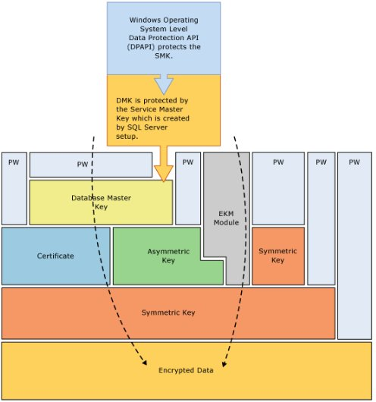
Encryption Hierarchy

Slide 18
Agenda
What is encryption?
Encryption in SQL Server
Communications
Transparent Data Encryption
Hashing
Keys
Symmetric Keys
Asymmetric Keys

Slide 19
Communications
Encrypt the connection to/from SQL Server
  Encrypt “the wire”
Two options
  SSL encryption from SQL Server
  IPSec encryption at the Windows host network layer.

Slide 20

SSL Communications
Install certificate on SQL Server, set the FORCE ENCRYPTION options
  Yes = required
  No = client option
Certificate must be valid based on the system time
DO NOT USE SELF SIGNED CERTIFICATES
All rules in BOL
  Encrypting Connections to SQL Server
  How to: Enable Encrypted Connections to the Database Engine

Slide 21
Agenda
What is encryption?
Encryption in SQL Server
Communications
Transparent Data Encryption
Hashing
Keys
Symmetric Keys
Asymmetric Keys

Slide 22
Transparent Data Encryption
TDE introduced in SQL Server 2008
Protects the data at rest by encrypting the data on disk.
  The transaction log is encrypted
  Backups are encrypted (can eliminate compression)
  Tempdb is encrypted for all operations.
  Replication data is not encrypted
  Filestream data is not encrypted

Slide 23
Transparent Data Encryption
Implemented with a simple ALTER DATABASE command
ALTER DATABASE AdventureWorks2008R2
SET ENCRYPTION ON;
GO
Encryption is handled by the Database Encryption Key (DEK)
Requires a Database Master Key (DMK) and a Certificate to protect the DEK
Backups of the certificate protecting the DEK are necessary to restore a backup.

Slide 24
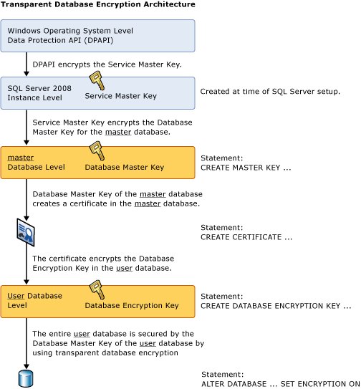
Transparent Data Encryption

Slide 25
Transparent Data Encryption
Demo
Notes:
Create unencrypted db. Detach. View with hex editor. Encrypt, detach, view.

Slide 26
Transparent Data Encryption
Overhead is < 5%
Enterprise Edition only (not BI edition)
Value?
Third Party Tools

Slide 27
Agenda
What is encryption?
Encryption in SQL Server
Communications
Transparent Data Encryption
Hashing
Keys
Symmetric Keys
Asymmetric Keys

Slide 28
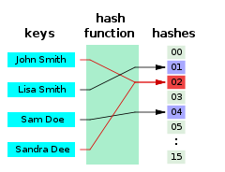
Hashing
“A hash function is any algorithm or subroutine that maps large data sets, called keys, to smaller data sets.” - Wikipedia

Slide 29
Hashing
SQL Server uses the HASHBYTES functions
CHECKSUM() or BINARY_CHECKSUM() can also be used.
other implementations using .NET/CLR are better. (see Expert SQL Server Encryption, Michael Coles)
SQL Server 2012 adds SHA2_256 and SHA2_512 algorithms.

Slide 30
Hashing
DEMO

Slide 31
Hashing or Encryption
Hashing is not really encryption
  Decryption is not supported (usually)
Hashing is deterministic, encryption is not
Hashing is quicker
In general, a hash of searchable data can be used to allow indexing of encrypted data.
  Caveat – Only hash the portion of the encrypted data needed for searching, e.g. last four digits of a credit card number.
Choose the strongest algorithm available in your version.
  SQL Server 2008 – SHA1
  SQL Server 2012 - SHA2_512

Slide 32
Agenda
What is encryption?
Encryption in SQL Server
Communications
Transparent Data Encryption
Hashing
Keys
Symmetric Keys
Asymmetric Keys

Slide 33
Keys
Multiple Keys in SQL Server
  Service Master Key
  Database Master Key
  Database Encryption Key
  Symmetric Keys
  Asymmetric Keys
  Certificates

Slide 34
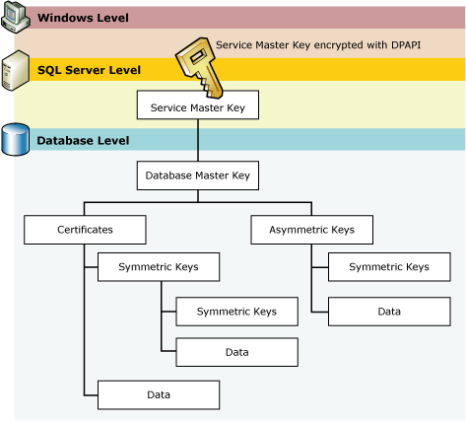
The Encryption Hierarchy

Slide 35
Service Master Key
Service Master Key = SMK
The Service Master Key is created when it is first needed. No CREATE DDL
Secured by Windows DPAPI (default)
Accessed by Service Account for database engine, or a principal with access to the service account name and password

Slide 36
Service Master Key
Must be manually backed up.
BACKUP SERVICE MASTER KEY
Must be restored in a DR situation to open other keys secured by this key (Database Master Keys)
Can be regenerated if necessary.
  This can cause data loss
Encryption is now AES

Slide 37
Database Master Key
Database Master Key = DMK
The Database Master Key is created by an administrator (CREATE/ALTER DDL)
This is secured by the SMK and a password (TripleDES encryption in 2008, AES in 2012)
This can be secured by password only (DROP ENCRYPTION BY SERVICE MASTER KEY option)

Slide 38
Database Master Key
Backup and restore using DDL commands
BACKUP MASTER KEY
RESTORE MASTER KEY
OPEN/CLOSE manually if not protected by the SMK
Attach/restore of an encrypted database requires the password for the DMK
You can alter the DMK to add SMK encryption after attach/restore

Slide 39
Agenda
What is encryption?
Encryption in SQL Server
Communications
Transparent Data Encryption
Hashing
Keys
Symmetric Keys
Asymmetric Keys

Slide 40
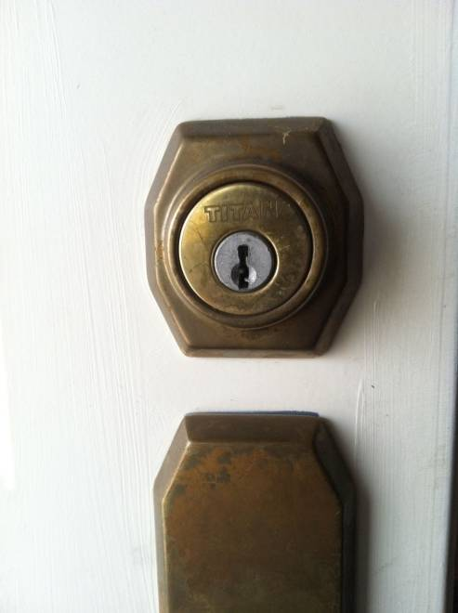
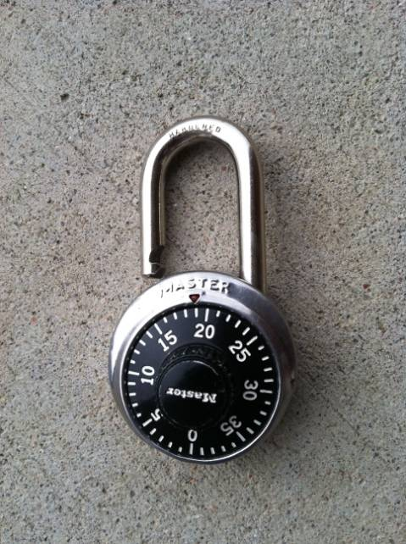
Symmetric Encryption
Like a normal key lock
The key that encrypts the data also decrypts the data

Slide 41
Symmetric Keys
Symmetric Keys are created in a database and are always in that database (cannot be backed up/restored)
Symmetric Keys are deterministic, and can be duplicated with the same creation parameters.
Symmetric keys require less resources than asymmetric keys, but there is still an additional CPU load from their use.

Slide 42
Symmetric Keys
The identity value always generates the same GUID for the key. These must be unique in a session.
The KEY_SOURCE and IDENTITY can be used to recreate a key. If you choose the same ones, and the same algorithm, you’ll get the same key
You can, and should, secure these keys with asymmetric keys

Slide 43
Symmetric Keys
DEMO

Slide 44
Symmetric Keys
The algorithm used is stored in the header of the encrypted data.
You can generate temporary keys for encryption/decryption
CREATE SYMMETRIC KEY #MyTempKey
Encryption with passphrases uses symmetric keys (TripleDES)

Slide 45
Agenda
What is encryption?
Encryption in SQL Server
Communications
Transparent Data Encryption
Hashing
Keys
Symmetric Keys
Asymmetric Keys

Slide 46
Asymmetric Encryption
Asymmetric keys are unlike keys and locks in the real world.
Based on factoring very large prime numbers.
More secure than symmetric keys
Require more resources for encryption/decryption than symmetric keys

Slide 47

Asymmetric Encryption
Key 1
0x26CD66B61E50369CBBDB42F484237370E02238EEAE588E06D00F8D0C6FAB5C48F68639ABB4003564CFB48A41BA373CFA411E99D3AB31A1B7CE40CB35
Now is the time for all good men to come to the aid of their country
Asymmetric Algorithm
Key 1
0x26CD66B61E50369CBBDB42F484237370E02238EEAE588E06D00F8D0C6FAB5C48F68639ABB4003564CFB48A41BA373CFA411E99D3AB31A1B7CE40CB35
0xE7A518047A8D3836B76006D9CE04DA2F803607A57CD7F9EE855FC3451EB02A076F28DD614BA841AC756E52CFEC4006746480C8204D579083C4AD0D627CAD24
Asymmetric Algorithm

Slide 48
Asymmetric Encryption
Key 1
0x26CD66B61E50369CBBDB42F484237370E02238EEAE588E06D00F8D0C6FAB5C48F68639ABB4003564CFB48A41BA373CFA411E99D3AB31A1B7CE40CB35
Now is the time for all good men to come to the aid of their country
Asymmetric Algorithm
Key 2
0x26CD66B61E50369CBBDB42F484237370E02238EEAE588E06D00F8D0C6FAB5C48F68639ABB4003564CFB48A41BA373CFA411E99D3AB31A1B7CE40CB35
Now is the time for all good men to come to the aid of their country
Asymmetric Algorithm

Slide 49


Asymmetric Encryption
Key 1 – Private Key
Key 2 – Public Key
Keys 1 and 2 are paired and generated together.
One is referred to as a private key and the other a public key. Only the user has the private key, but the public key is distributed to everyone

Slide 50
Asymmetric Encryption
Anyone encrypts with Steve’s Public Key
0x26CD66B61E50369CBBDB42F484237370E02238EEAE588E06D00F8D0C6FAB5C48F68639ABB4003564CFB48A41BA373CFA411E99D3AB31A1B7CE40CB35
Now is the time for all good men to come to the aid of their country
Asymmetric Algorithm
0x26CD66B61E50369CBBDB42F484237370E02238EEAE588E06D00F8D0C6FAB5C48F68639ABB4003564CFB48A41BA373CFA411E99D3AB31A1B7CE40CB35
Only Steve can decrypt with his private key
Now is the time for all good men to come to the aid of their country
Asymmetric Algorithm

Slide 51
Asymmetric Encryption
Steve can encrypt with his private key
0x26CD66B61E50369CBBDB42F484237370E02238EEAE588E06D00F8D0C6FAB5C48F68639ABB4003564CFB48A41BA373CFA411E99D3AB31A1B7CE40CB35
Now is the time for all good men to come to the aid of their country
Asymmetric Algorithm
0x26CD66B61E50369CBBDB42F484237370E02238EEAE588E06D00F8D0C6FAB5C48F68639ABB4003564CFB48A41BA373CFA411E99D3AB31A1B7CE40CB35
Anyone can decrypt with Steve’s public key
Now is the time for all good men to come to the aid of their country
Asymmetric Algorithm

Slide 52
Asymmetric Encryption
Steve can encrypt with his private key
0x26CD66B61E50369CBBDB42F48423737
Now is the time
Steve encrypts again with Andy’s Public Key
0x26CD66B61E50369CBBDB42F48423737
0x48385D8A87BD329FF328E476BC234

Slide 53
Asymmetric Encryption
Andy decrypts the outer message with his private key
0x48385D8A87BD329FF328E476BC234
0x26CD66B61E50369CBBDB42F48423737
Andy then decrypts with Steve’s Public key to verify the message is from Steve
0x26CD66B61E50369CBBDB42F48423737
Now is the time

Slide 54
Asymmetric Encryption
Use DDL to create asymmetric keys (CREATE/DROP/ALTER)
Can be created outside the server (FROM FILE option)
  SN.exe (Visual Studio SDK)
  Makecert (Windows SDK)

Slide 55
Asymmetric Encryption
You can encrypt an asymmetric key with a password.
  This will be required for decryption
  Not required for encryption
Asymmetric keys are usually used to encrypt symmetric keys, which encrypt the data. This balances security with resources
You can remove the private key (prevents decryption in that db).

Slide 56
Certificates
Certificates are asymmetric keys with additional metadata.
Expiration dates are not enforced by SQL Server
  Administrators must decrypt/re-encrypt the data and remove the old certificates
  Useful for marking the key rotation dates (query sys.certificates)
To restore certificates, use CREATE CERTIFICATE.
SQL Server 2012 increases the maximum certificate length to 4,096.
Always use the longest length you can.

Slide 57
Asymmetric Encryption
Demo

Slide 58
Key Length
Use long keys
DKIM attack on Google’s mail system*
  384 bit key cracked on high end laptop
  512 bit key cracked for ~$75 using AWS
  768 bit key could be cracked by large orgs
  This changes all the time
  www.wired.com/threatlevel/2012/10/dkim-vulnerability-widespread/all/

Slide 59
The End
Questions?
Don’t forget to fill out your evaluations
Resources at the end of the PPT
www.sqlservercentral.com/forums
www.voiceofthedba.com/talks

Slide 60
References
Encryption - http://en.wikipedia.org/wiki/Encryption
Understanding TDE - http://msdn.microsoft.com/en-us/library/bb934049.aspx
Hash Function - http://en.wikipedia.org/wiki/Hash_function
Rainbow Tables - http://en.wikipedia.org/wiki/Rainbow_table
Transparent Data Encryption – https://www.simple-talk.com/sql/database-administration/transparent-data-encryption/
How to enable/remove Transparent Data Encryption (TDE) - http://blogs.msdn.com/b/batuhanyildiz/archive/2012/10/16/how-to-enable-remove-transparent-data-encryption-tde.aspx
Sys.database_encryption_keys - http://msdn.microsoft.com/en-us/library/bb677274.aspx
TDE and Backup Compression - http://sqlcat.com/sqlcat/b/technicalnotes/archive/2009/02/16/tuning-backup-compression-part-2.aspx
Encrypting Connections to SQL Server - http://msdn.microsoft.com/en-us/library/ms189067.aspx

Slide 61
References
HASHBYTES - http://msdn.microsoft.com/en-us/library/ms174415.aspx
CHECKSUM() - http://msdn.microsoft.com/en-us/library/ms189788.aspx
BINARY_CHECKSUM() - http://msdn.microsoft.com/en-us/library/ms173784.aspx
Expert SQL Server Encryption - http://www.amazon.com/gp/product/1430224649?ie=UTF8&amp;tag=redgatsof-20&amp;linkCode=as2&amp;camp=1789&amp;creative=9325&amp;creativeASIN=1430224649
Data Hashing in SQL Server - http://blogs.msdn.com/b/sqlsecurity/archive/2011/08/26/data-hashing.aspx

Slide 62
References
CREATE ASYMMETRIC KEY - http://technet.microsoft.com/en-us/library/ms174430.aspx
ALTER ASYMMETRIC KEY - http://technet.microsoft.com/en-us/library/ms187311.aspx
CREATE CERTIFICATE - http://technet.microsoft.com/en-us/library/ms187798.aspx
ALTER CERTIFICATE - http://technet.microsoft.com/en-us/library/ms189511.aspx
BACKUP CERTIFICATE - http://technet.microsoft.com/en-us/library/ms178578.aspx
sys.certificates - http://technet.microsoft.com/en-us/library/ms189774.aspx
ENCRYPTBYPASSPHRASE - http://technet.microsoft.com/en-us/library/ms188910.aspx
ENCRYPTBYKEY - http://technet.microsoft.com/en-us/library/ms174361.aspx
ENCRYPTBYASYMKEY - http://technet.microsoft.com/en-us/library/ms186950.aspx

Slide 63
References
ENCRYPTBYCERT - http://technet.microsoft.com/en-us/library/ms188061.aspx
DECRYPTBYKEY - http://technet.microsoft.com/en-us/library/ms181860.aspx
DECRYPTBYASYMKEY - http://technet.microsoft.com/en-us/library/ms189507.aspx
DECRYPTBYCERT - http://technet.microsoft.com/en-us/library/ms178601.aspx
DECRYPTBYKEYAUTOASYMKEY - http://technet.microsoft.com/en-us/library/ms365420.aspx
DECRYPTBYKEYAUTOCERT - http://technet.microsoft.com/en-us/library/ms182559.aspx

Slide 64
References
http://blogs.msdn.com/b/raulga/archive/2006/03/11/549754.aspx
Windows SDK (Makecert) - http://msdn.microsoft.com/en-us/windowsserver/bb980924.aspx
SN.EXE - http://msdn.microsoft.com/en-us/library/k5b5tt23.aspx
Subway Hacked - http://arstechnica.com/business/news/2011/12/how-hackers-gave-subway-a-30-million-lesson-in-point-of-sale-security.ars
Install SSL Certificate - http://blogs.msdn.com/b/jorgepc/archive/2008/02/19/enabling-certificates-for-ssl-connection-on-sql-server-2005-clustered-installation.aspx
Encrypting Connections to SQL Server - http://msdn.microsoft.com/en-us/library/ms189067.aspx
SQL Server 2005: A look at the master keys - part 2 - http://blogs.msdn.com/b/lcris/archive/2005/09/30/475822.aspx
Cryptography in SQL Server http://msdn.microsoft.com/en-us/library/cc837966%28v=sql.100%29.aspx

Slide 65
Images
Enigma Machine - http://www.flickr.com/photos/badwsky/34164244/
The Encryption Hierarchy from BOL - http://msdn.microsoft.com/en-US/library/ms189586%28v=SQL.90%29.aspx
Hashing Image - http://upload.wikimedia.org/wikipedia/commons/thumb/5/58/Hash_table_4_1_1_0_0_1_0_LL.svg/240px-Hash_table_4_1_1_0_0_1_0_LL.svg.png
TDE Structure - http://msdn.microsoft.com/en-us/library/bb934049.aspx

